Slide 1

Recurrent Neural Networks

Slide 2
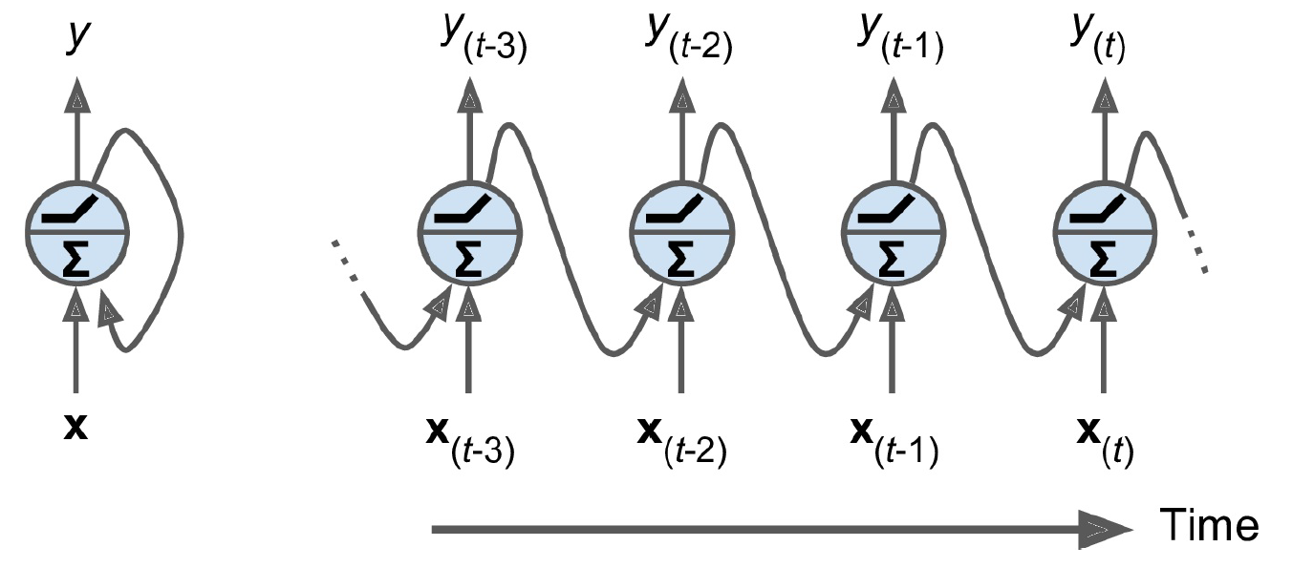
Recurrent Neurons
Notes:
Y(t)和x(t),x(t-1),x(t-2)…都有关。

Slide 3
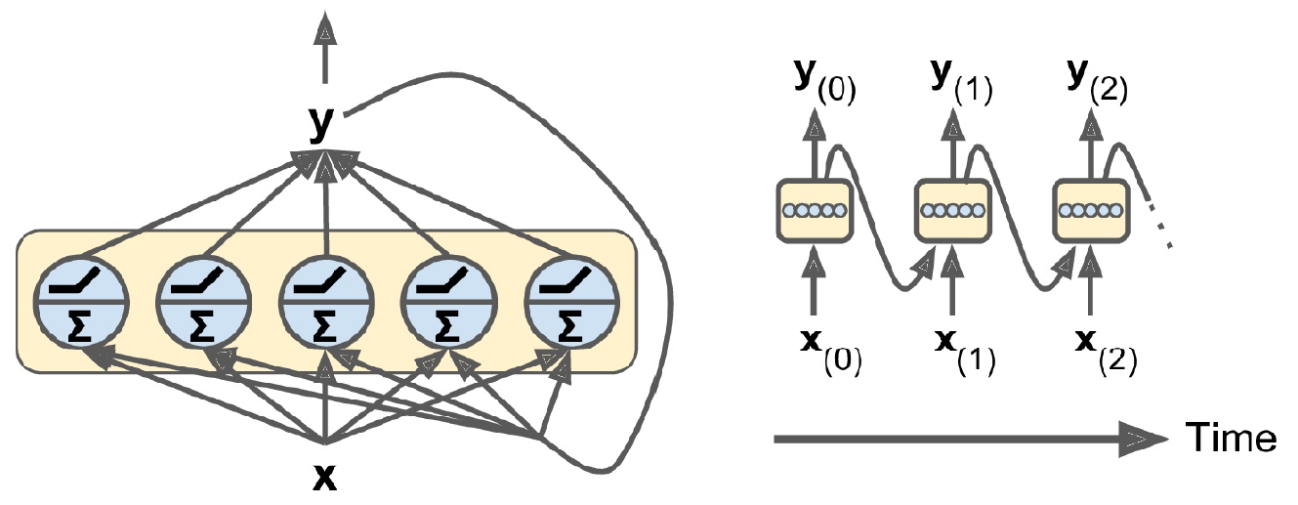
Recurrent Layers

Slide 4
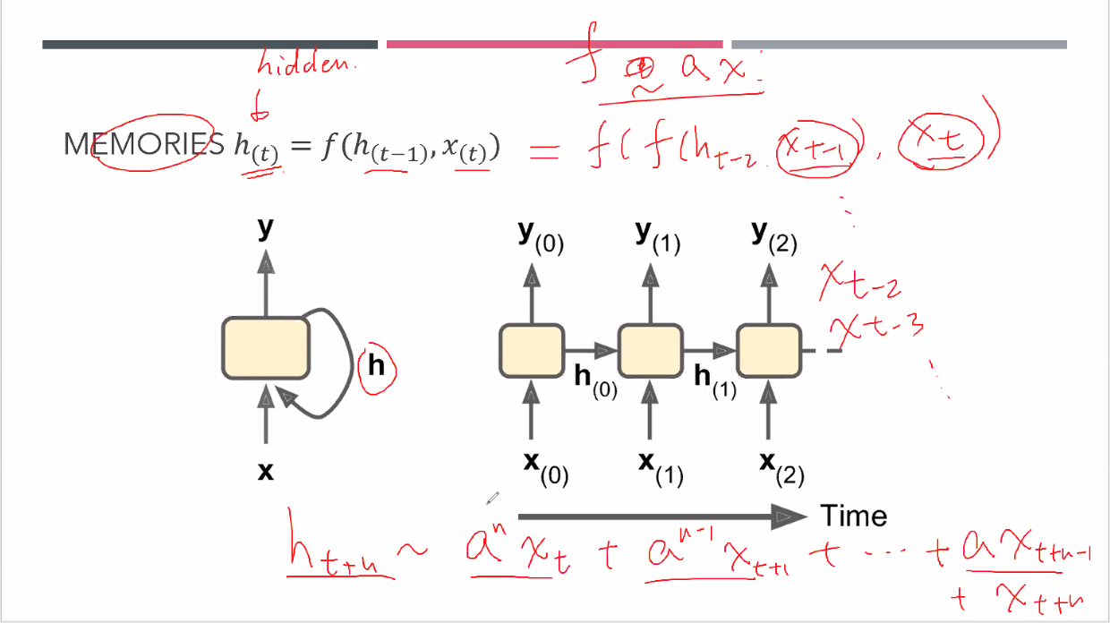
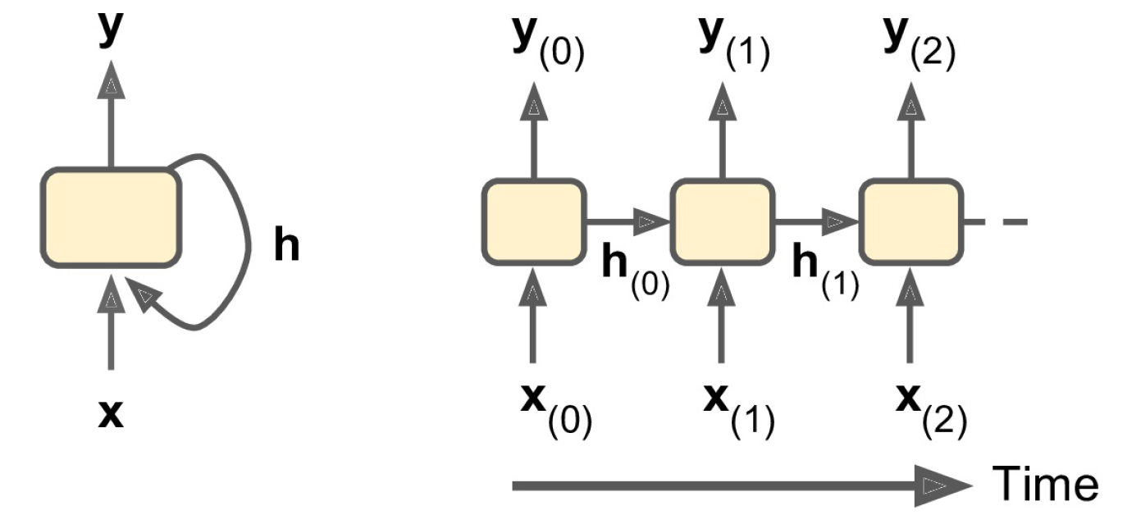

Memories $h_{(t)}=f(h_{\left(t−1\right)},x_{\left(t\right)})$
Notes:
H(t)是hidden的。
Ht和ht-1，ht-2…和xt，xt-1…有关。类似于记忆，和以前的h和x有关，只是越远的，记忆越模糊。例如上面的式子，f(ht-1,xt)=f(f(ht-2,xt-1),xt)（越远，需要越多的f和x）

Slide 5
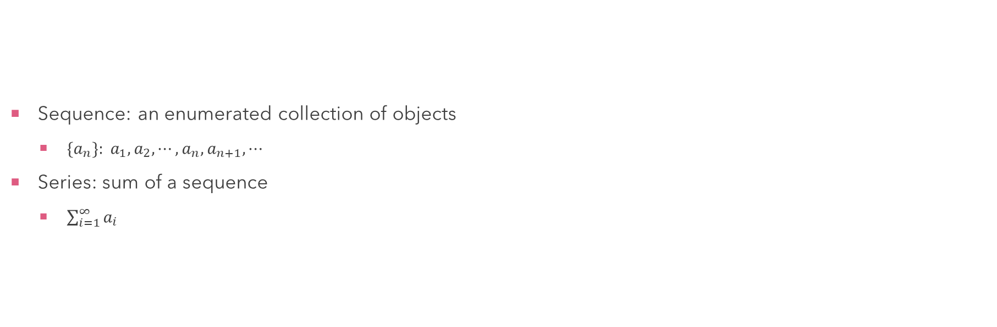
Sequence and Series
Sequence: an enumerated collection of objects
$\{a_{n}\}: a_{1}, a_{2}, ⋯, a_{n}, a_{n+1}, ⋯$
Series: sum of a sequence
$\sum_{i=1}^{∞}{a_{i}}$
Notes:
Series是sequence的和

Slide 6
Time Series
a series of data points indexed in time order
a sequence taken at successive equally spaced points in time
a sequence of discrete-time data
Notes:
Time series是时间来做index，每个间隔差都是一样的

Slide 7
Time Series
Trend
Seasonality
Amplification
Noise

